Slide 1
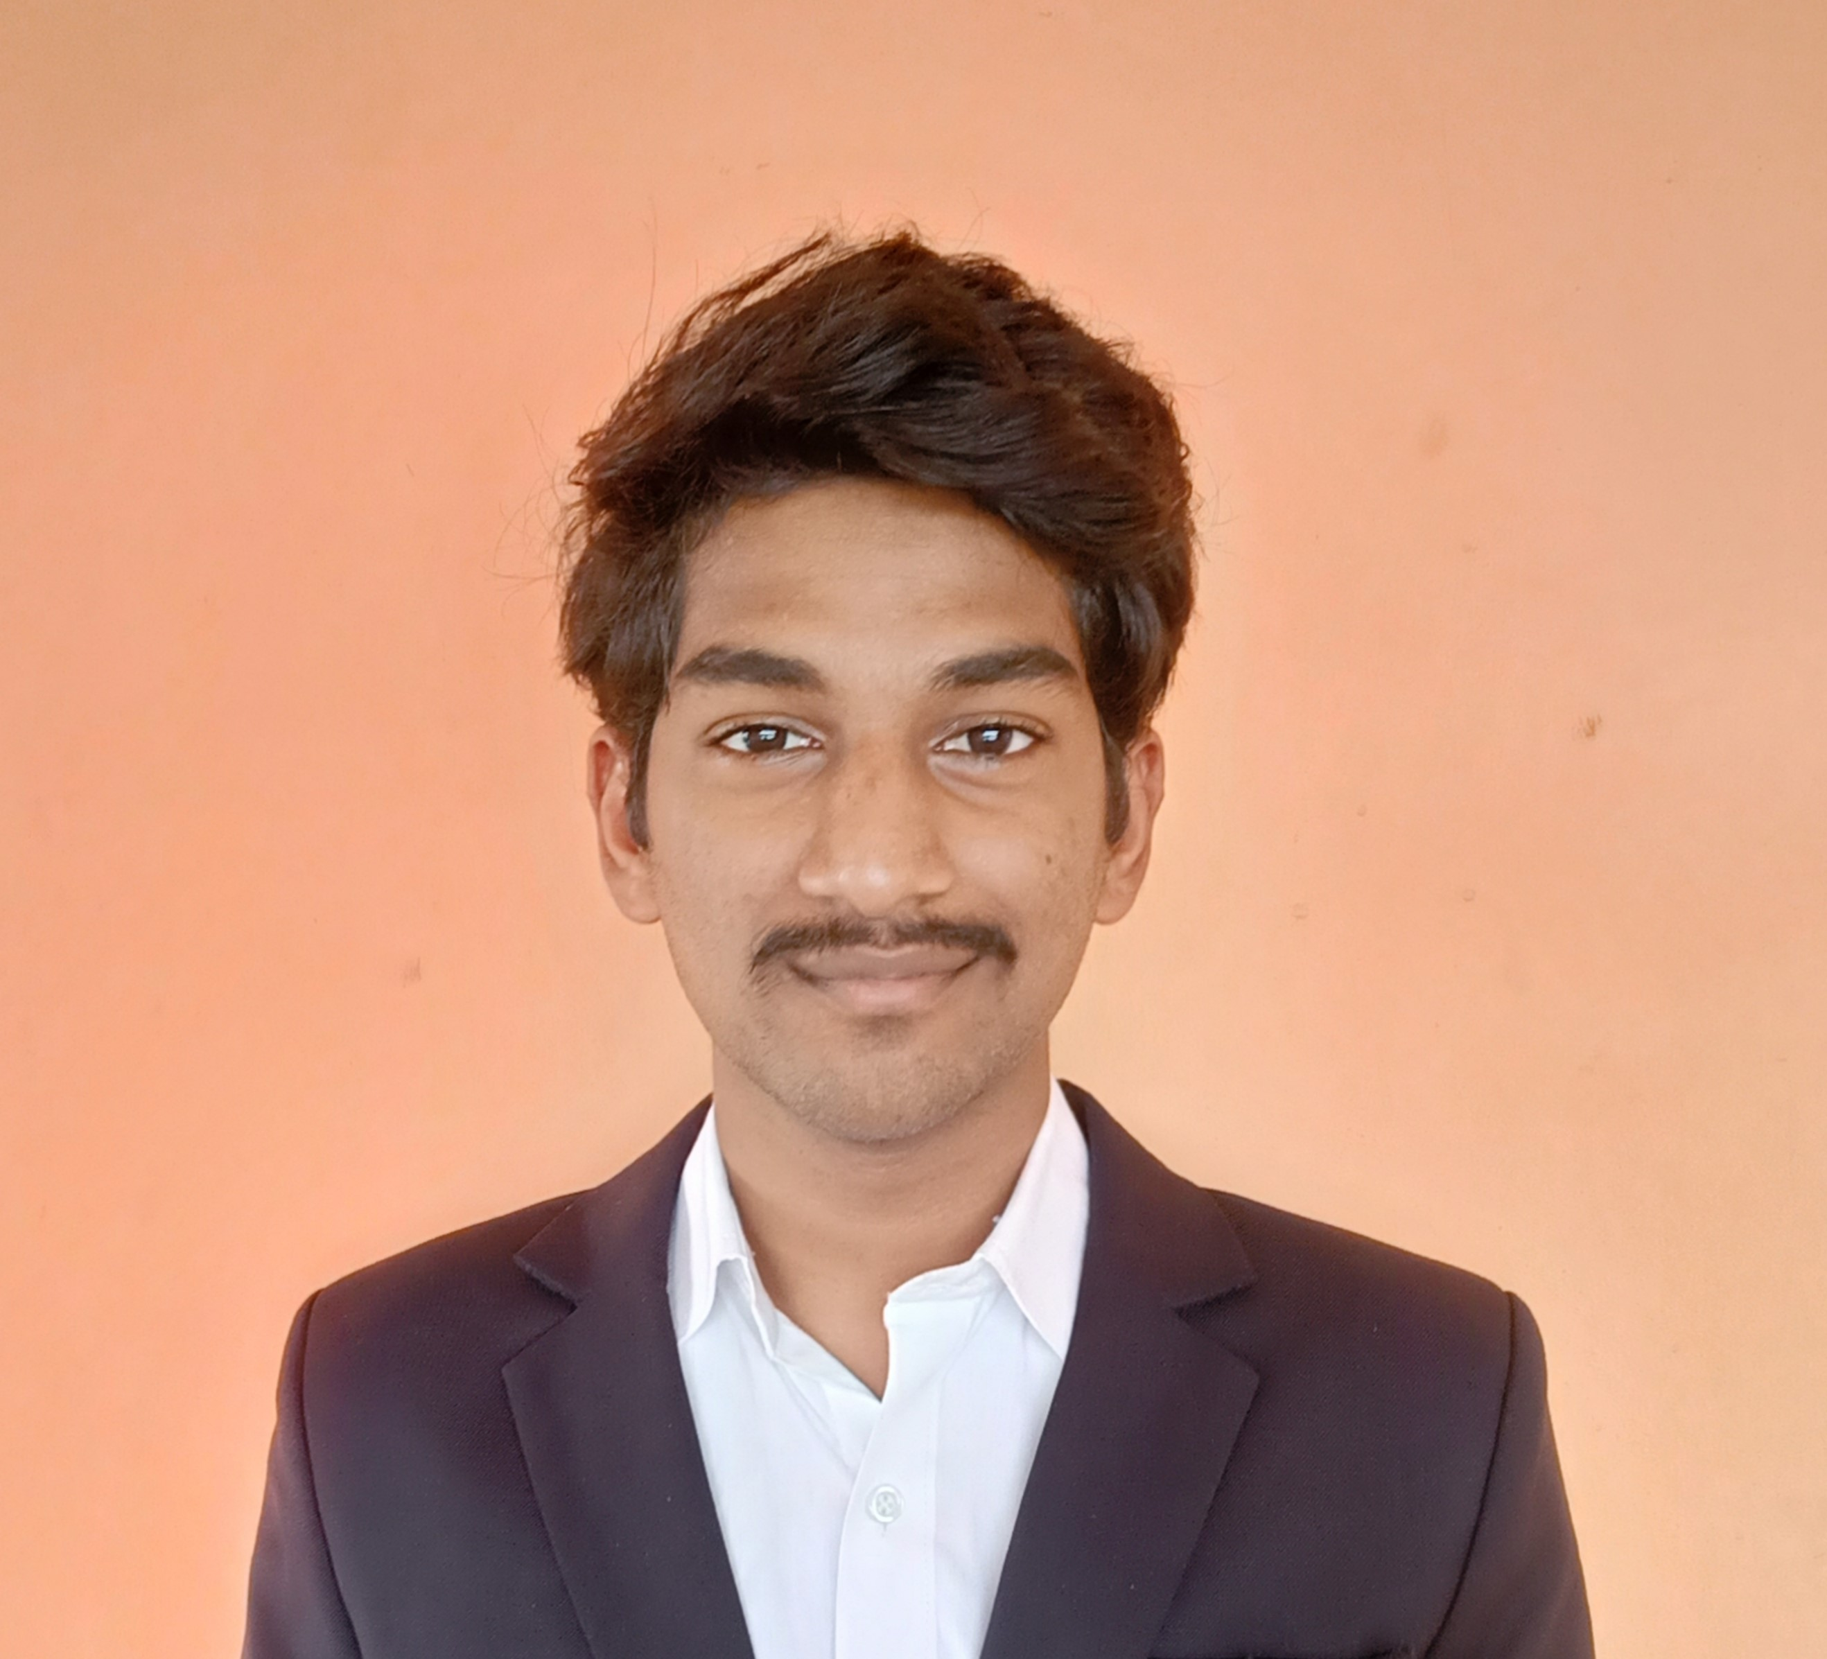

S SAI KIRAN
Analyst/Software Engineer
I Transform L&D left shift batch
Vel tech university ,B.Tech,
Computer Science & Eng: 2018-2022
Skills
C# | Basics, OOPS, Exception Handling ,Arrays ,Collection and Generics, Delegates and Events, File Io and Serialization.
.NET Framework | ADO.NET,ASP.NET with MVC5 and WEB API , Entity Framework
Database | SQL
Tools | GIT
UI Technology | HTML5 ,CSS & Angular
Add On Skills | Communication Skills, Team Management, UI Designing (Sketching).
chennai
sundarasaikiran@gmail.com
+91 8790938346
A4
.NET Core Full Stack Developer
Understanding of RDMS concepts using SQL Server.
Practical understanding of C# and SQL concepts using Visual Studio and SQL Server.
Hands on experience in developing applications using .NET Framework, Asp. Net Core.
Understanding of HTML5 , CSS and Angular CLI.
Proficient in creating Single page Web Application in Angular with Authentication with routing.
Trained under I Transform.
Pharmacy Management System
Completed case study on Pharmacy-Management System where the users can able to see all the drugs available in the pharmacy and place order according to their requirement, where as admins can be able to do all crud operations for drugs, suppliers details and able to see new orders ,Email conformation to the user and able to download sales report
Technologies used:
ANGULAR
ASP.NET CORE
Microsoft SQL Server
Video Link : Click
GitHub Link
https://github.com/sdsameer07

